Slide 1
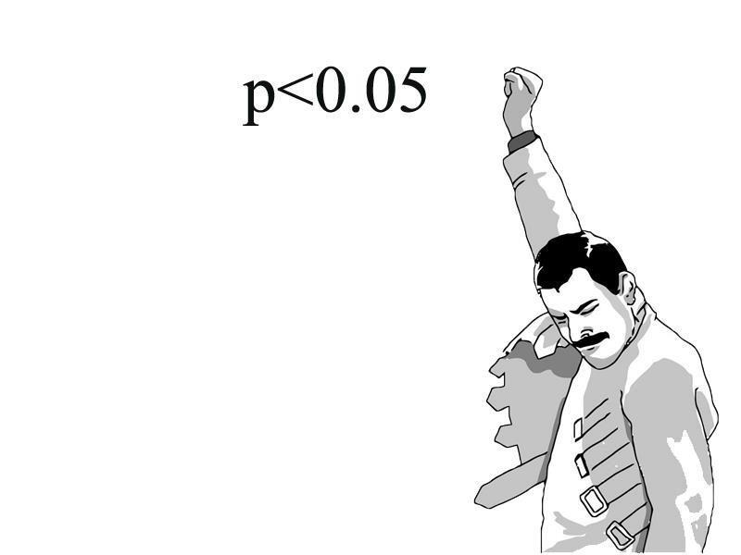


Student's t-test (t-Test)
MSc. Kian Jenab
PhD student
Devision of Terrestrial Ecosystem Research
Centre for Microbiology and Environmental Systems Science
University of Vienna
Email: kian.jenab@univie.ac.at

Slide 2
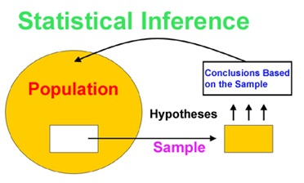
Statistical Inference
makes use of information from a sample to draw conclusions (inferences) about the population

Slide 3
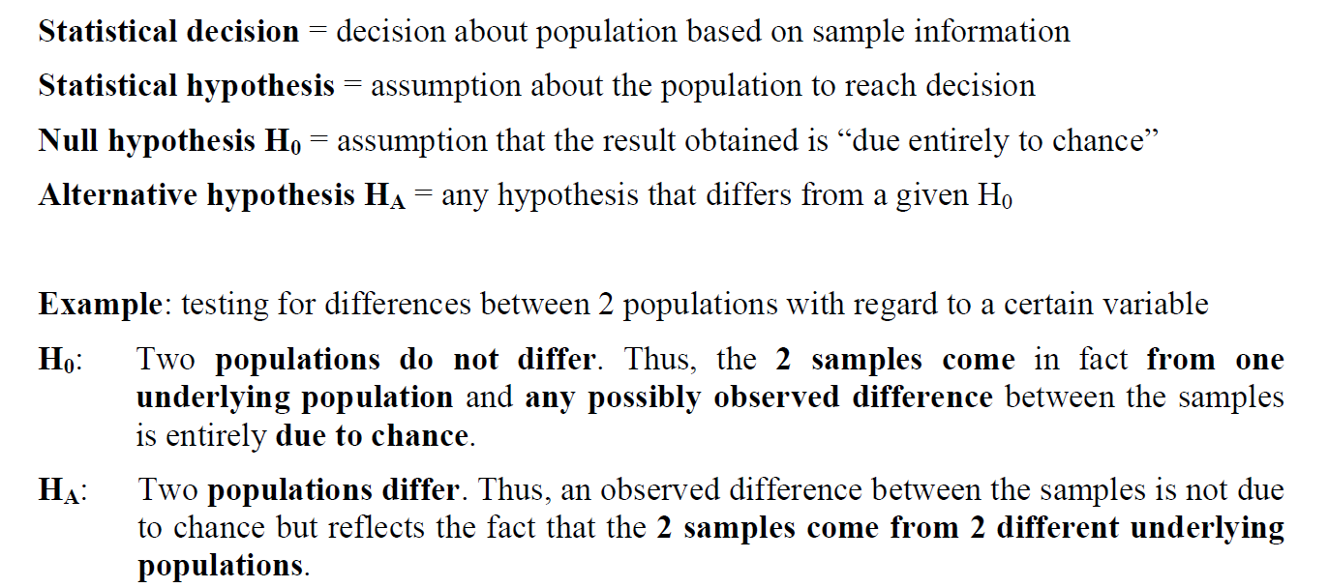
Statistical Hypothesis

Slide 4

P value (P)
Main result of a statistical test is the p value
Measure of uncertainty for drawing conclusions
The p-value is the probability that the null hypothesis is true
sample ➔ population (chance!)
Level of significance: A level of the p value at which the null hypothesis is rejected and the alternative hypothesis is accepted.
Biology: P < 0.05

Slide 5
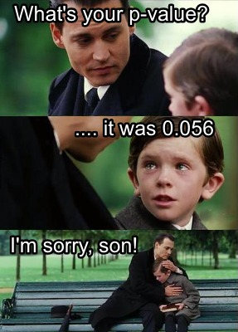
P value (P)
P < 0.05
Accept H_{A}
Reject H₀
P > or = 0.05
Accept H₀
Reject H_{A}
The p-value always evaluates the null hypothesis

Slide 6
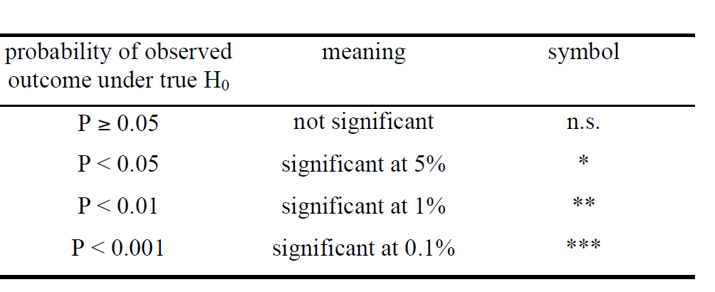
Student’s t-test
Difference between means two populations or groups mean (µ₁, µ₂)
H₀: There is no difference between means of two populations (µ₁= µ₂)
P > or = 0.05
H₁: There is significant difference between means of two populations (µ₁> or < µ₂)
P < 0.05
M (m)= 180
M (f)= 176

Slide 7
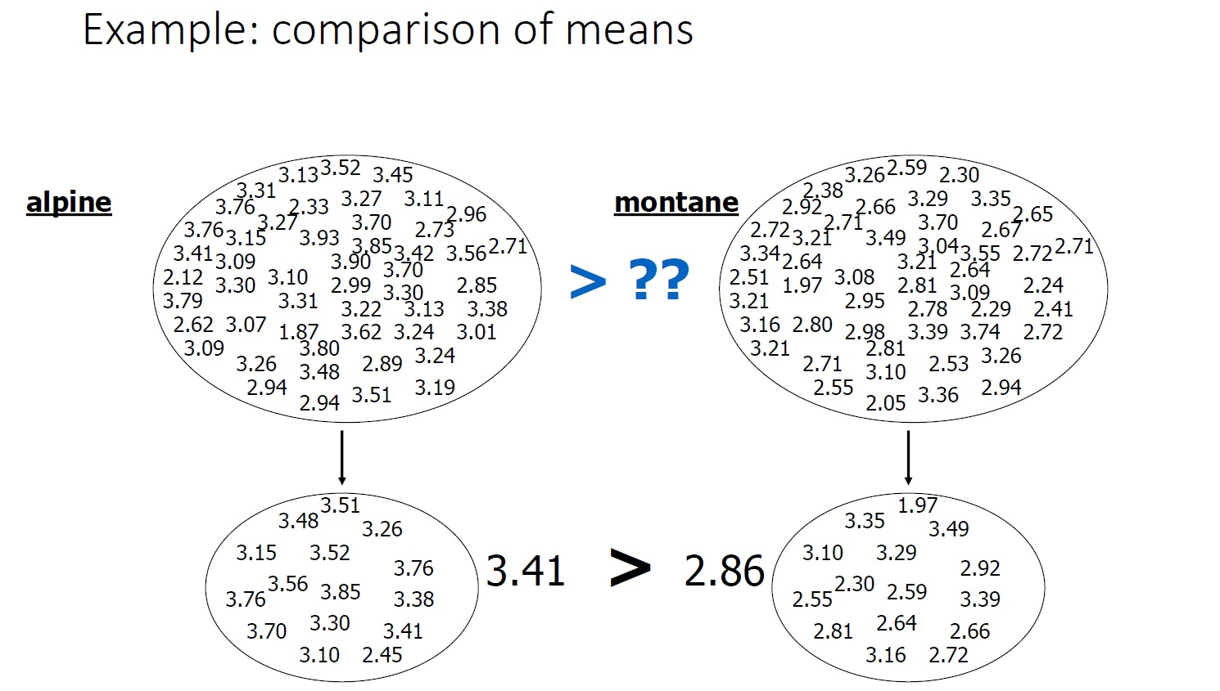

Slide 8
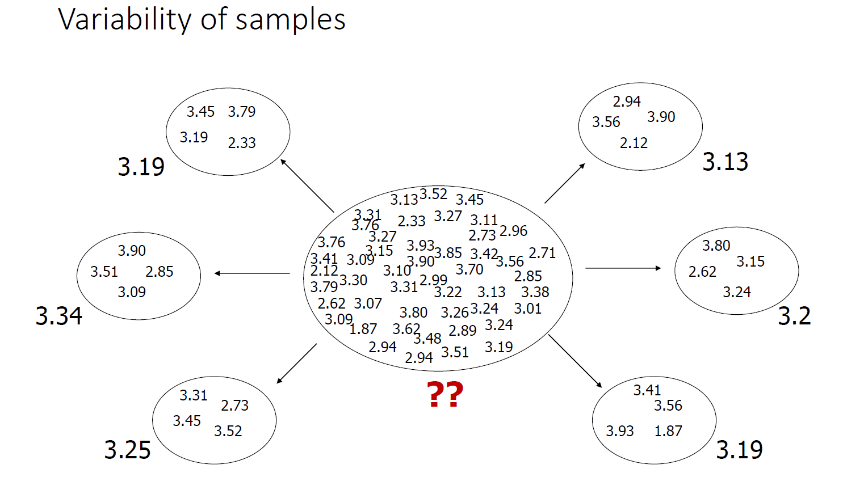

Slide 9
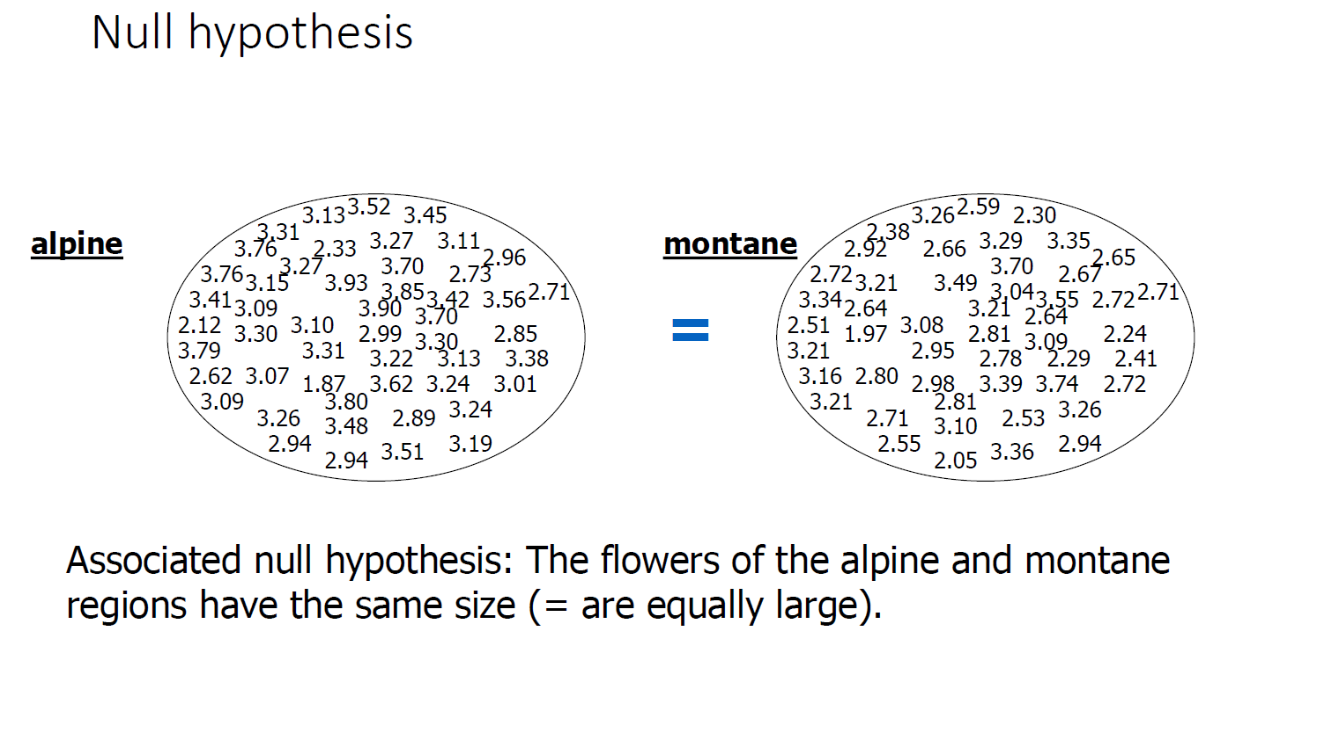

Slide 10
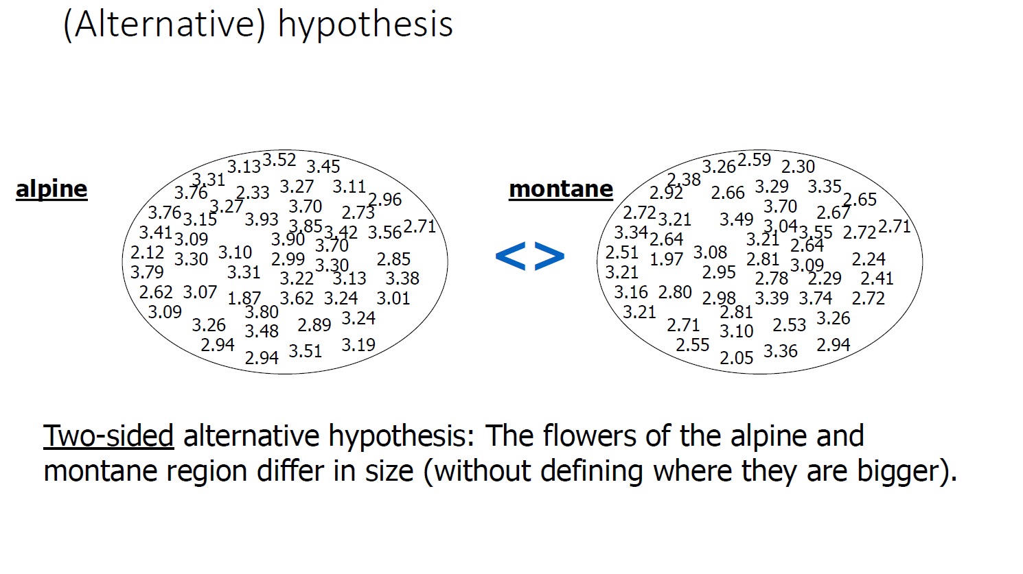

Slide 11
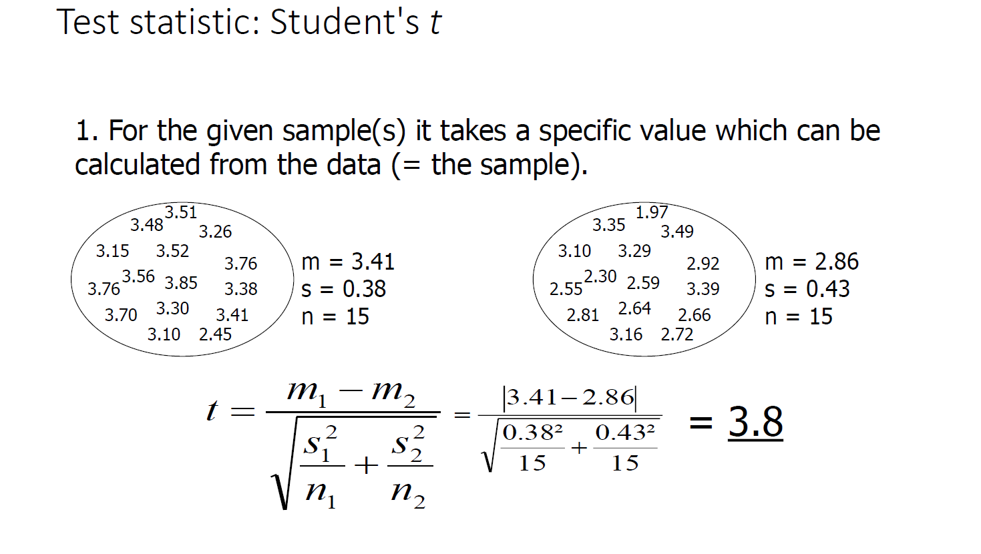

Slide 12
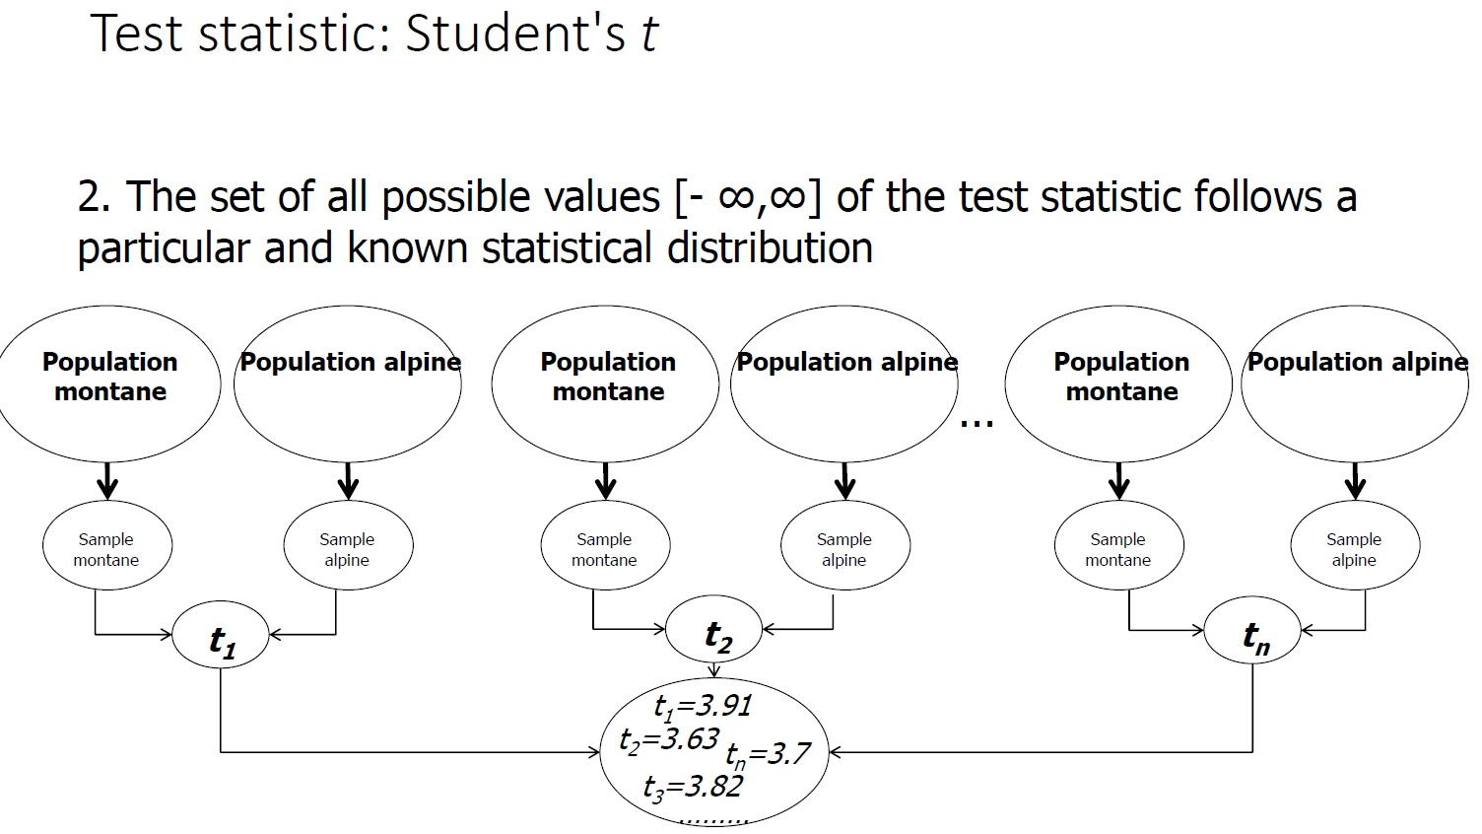

Slide 13
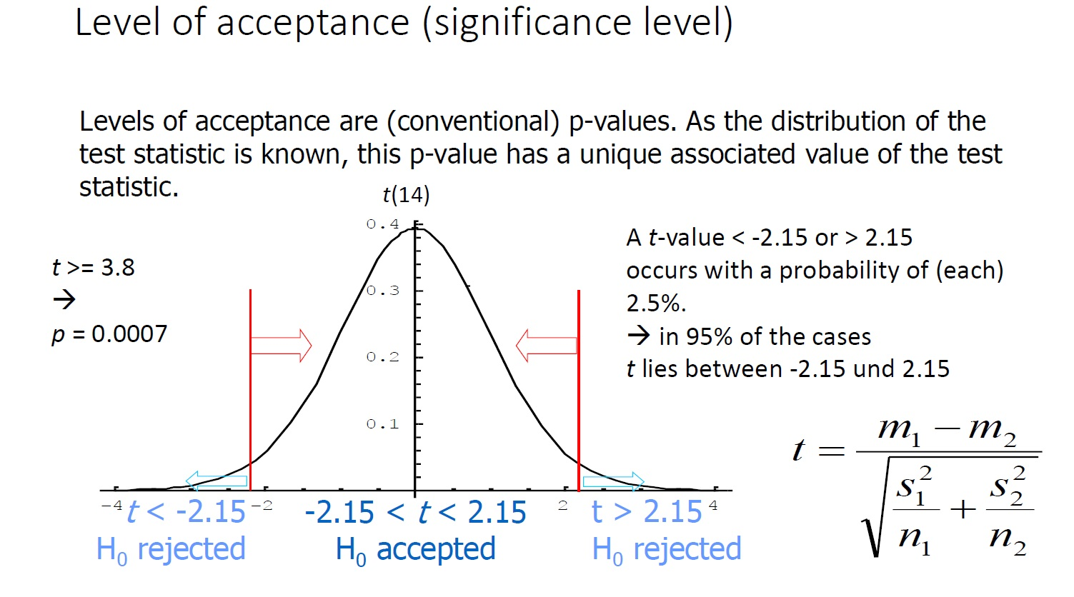
Degrees of freedom = (n1+n2)-2

Slide 14
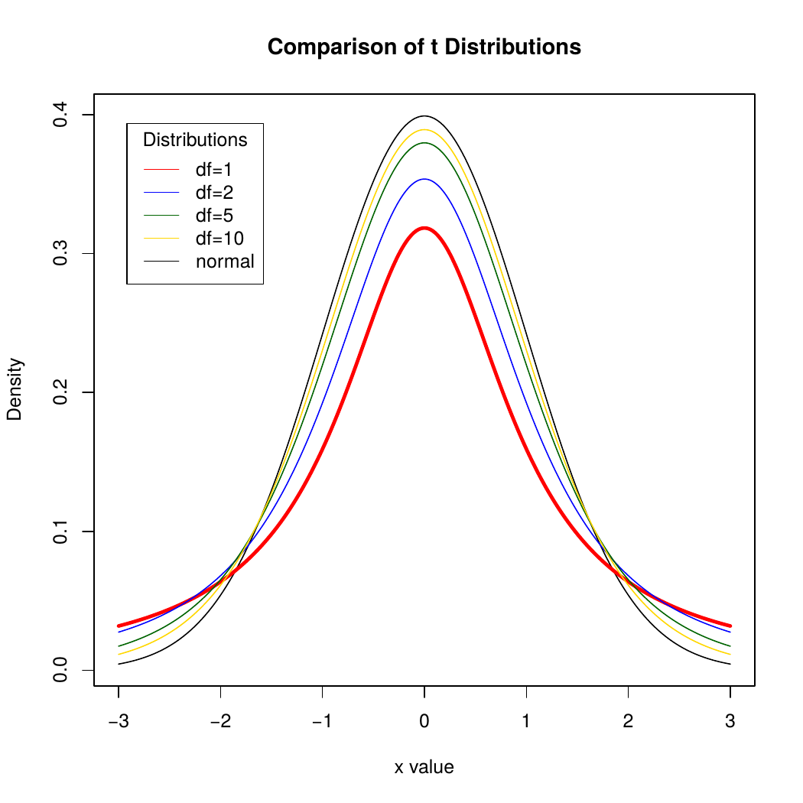

Slide 15
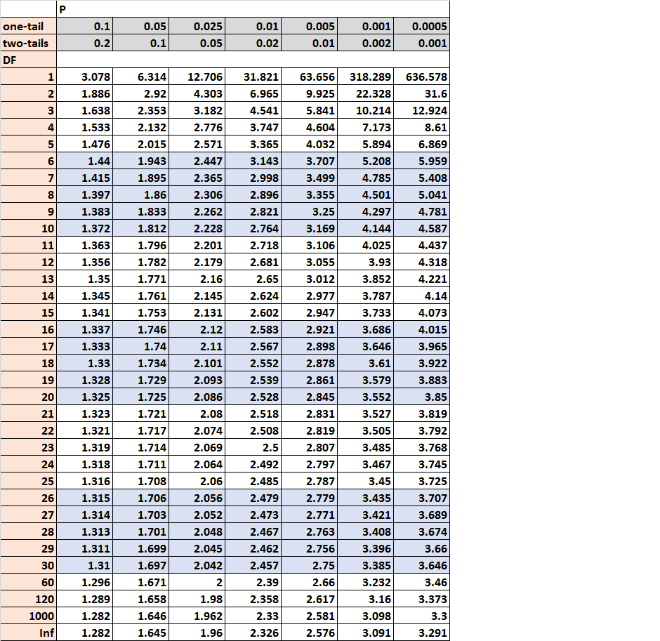

Slide 16
t-test Assumptions
The two populations have the same variance. This assumption is called homogeneity of variance.
The populations are normally distributed.
Each value is sampled independently from each other value.

Slide 17

Test of Normality
Test: Shapiro-Wilk test
H₀: Normal distribution
P > or = 0.05
H₁: Other distributions
P < 0.05
If it is not normal: Transformation ( Square root or logarithm)

Slide 18
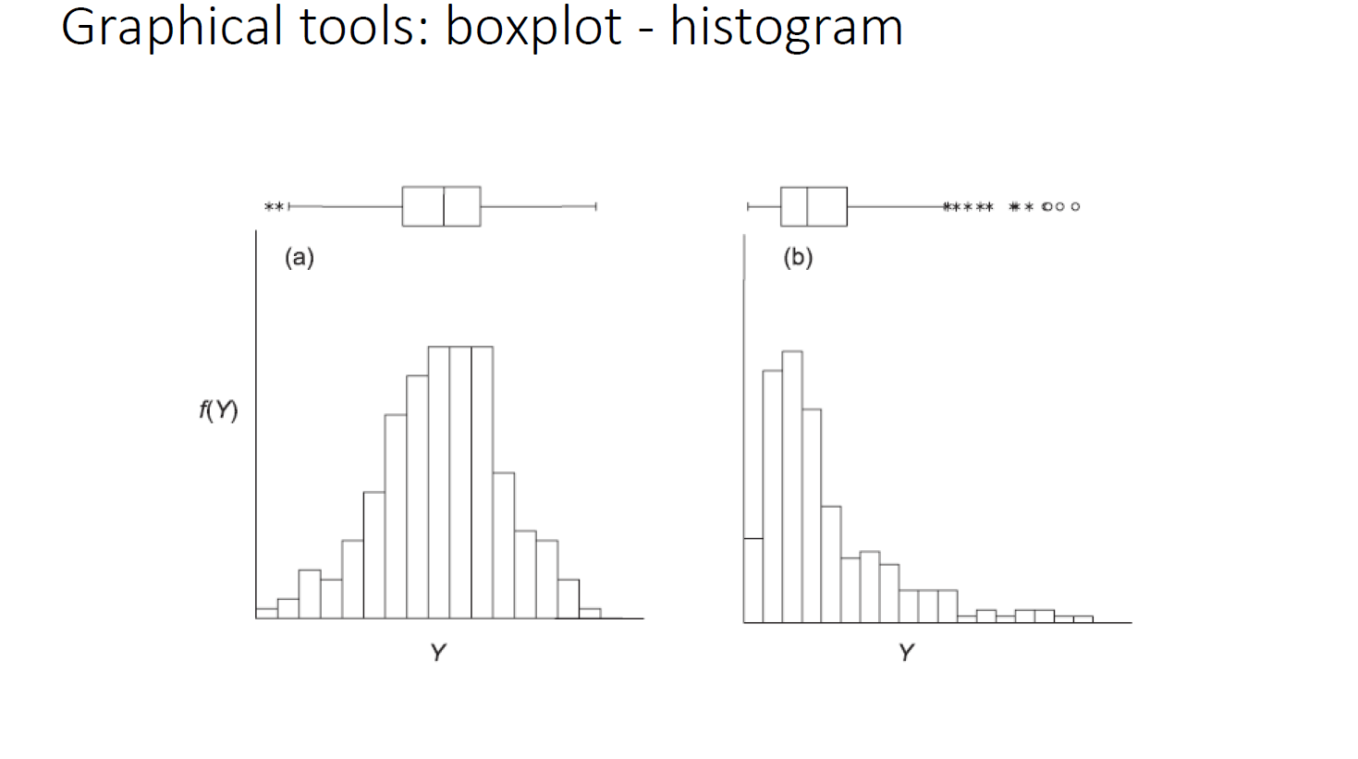

Slide 19
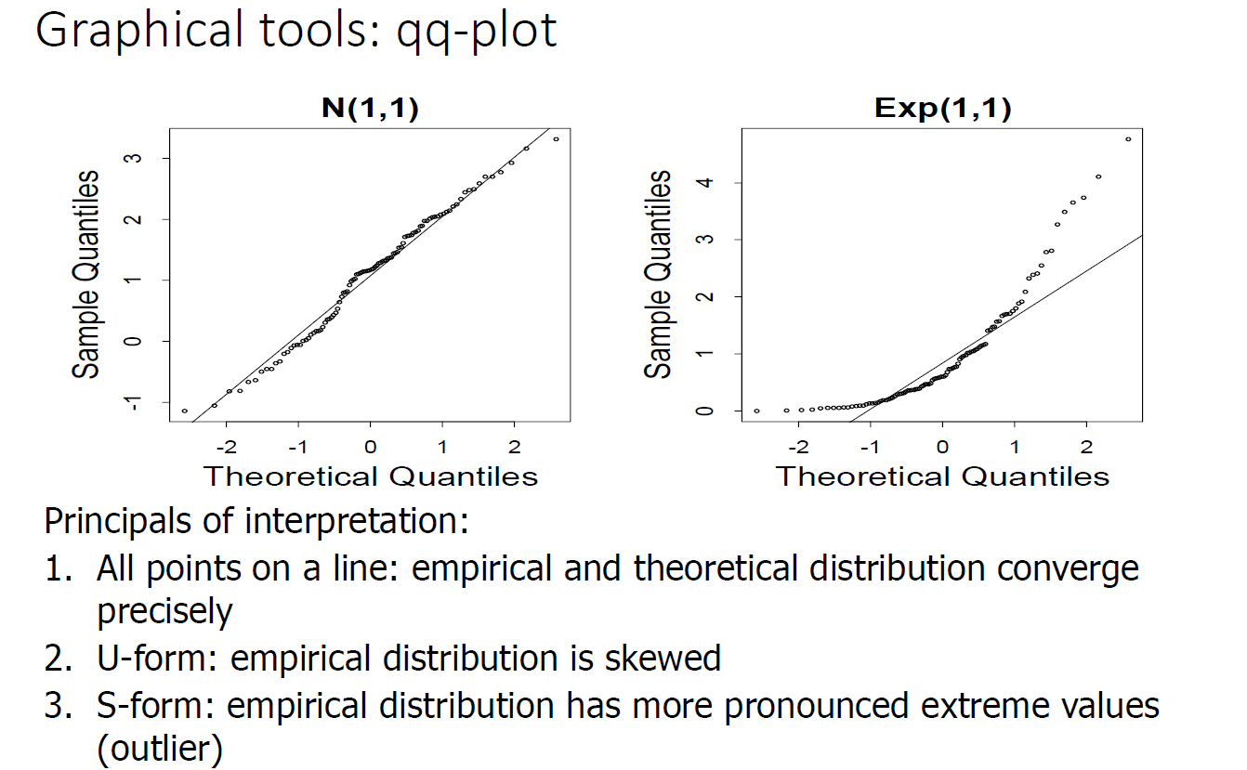

Slide 20
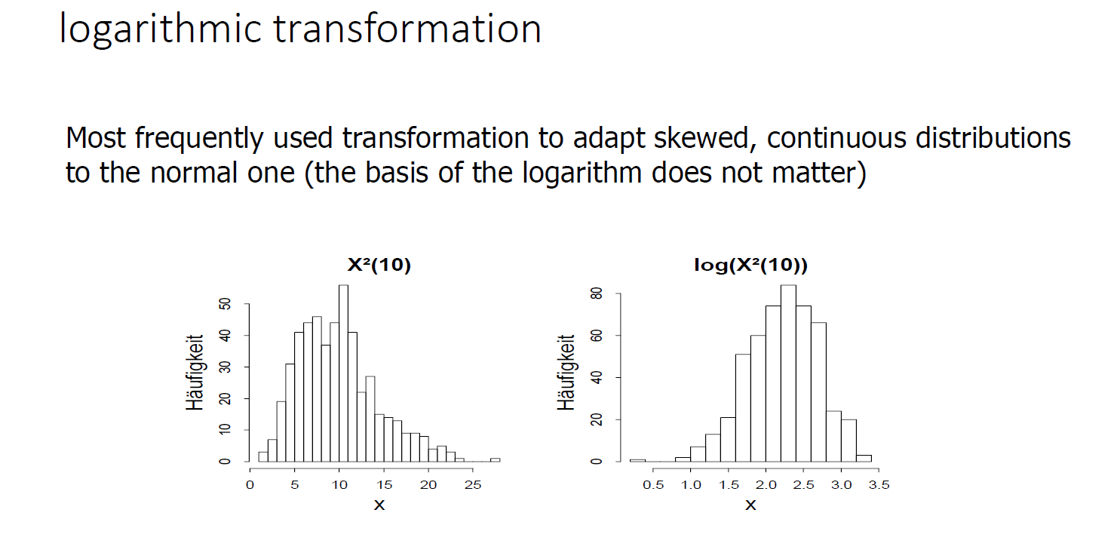

Slide 21
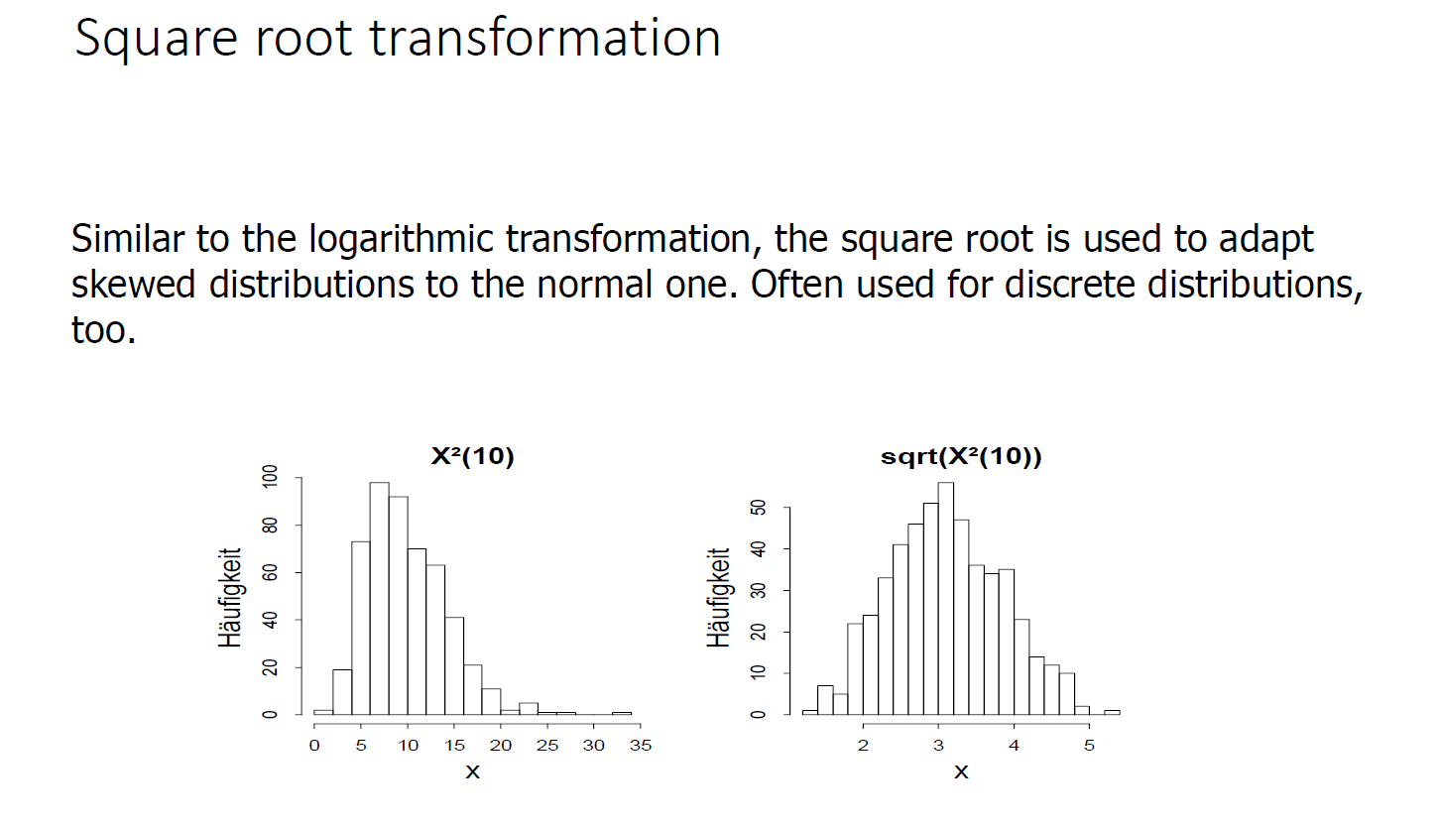

Slide 22
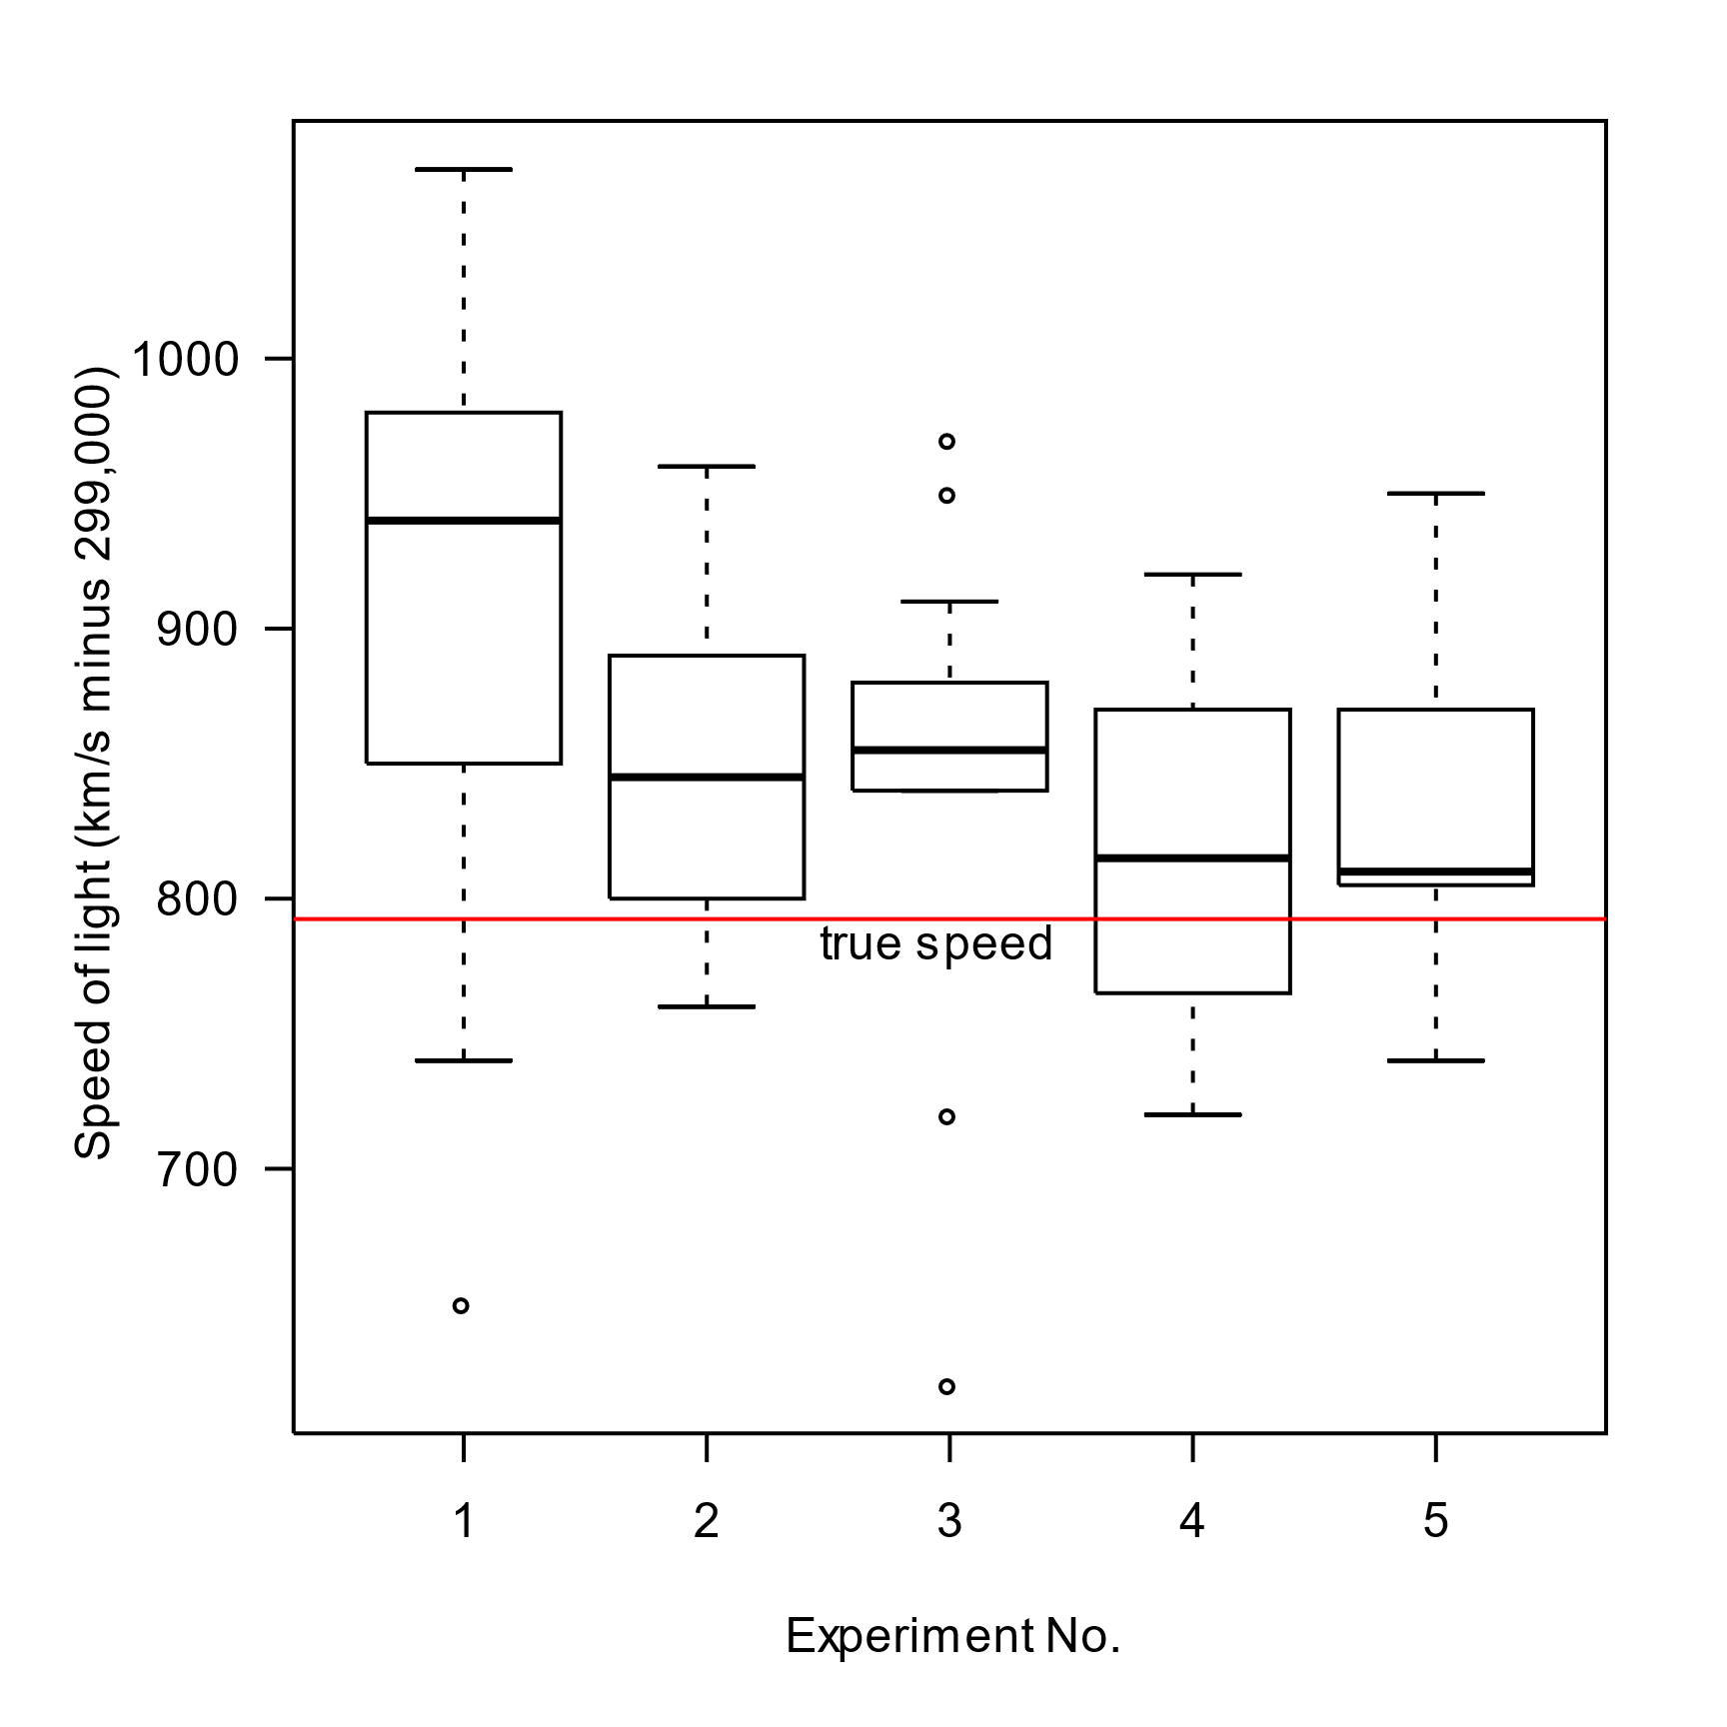
Homogeneity of Variance
Test: Leven’s test
H₀: The variances are equal
P > or = 0.05
H₁: The variances are not equal
P < 0.05

Slide 23
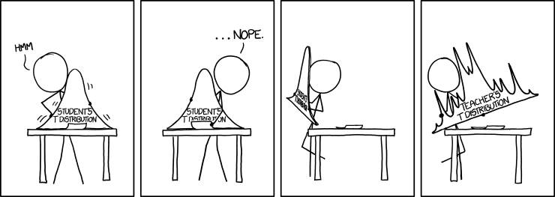
Student’s t-test
Unpaired t-test
Two different group
Example: Means of men and women’s height
Paired t-test
One group at two different time points
Example: Progress in exams
Midterm exam vs, final exam,

Slide 24
Unpaired Student’s t-test
Equal Variance (or Pooled) T-Test The Variances are equal
Normal distribution
Unequal Variance T-Test
The Variances are not equal
Normal distribution

Slide 25
Report a T-Test Result
There was a significant (not a significant) difference in tooth length for vitamin C (M=___, SD=___) and orange juice (M=___, SD=___) treatments (t(df)=____, p = ____)
There was a significant (not a significant) difference in tooth length for vitamin C (M= 16.2 , SD= 4.2) and orange juice (M= 18.3, SD= 5.1) treatments (t(10)= 3.81, p = 0.02)

Slide 26
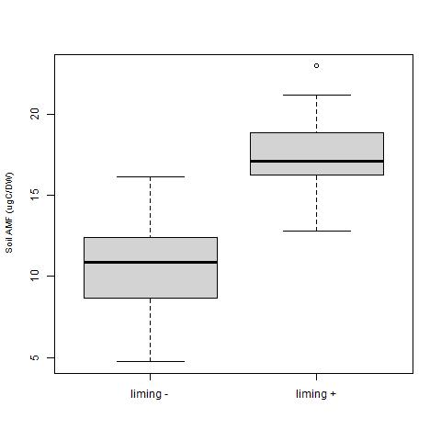
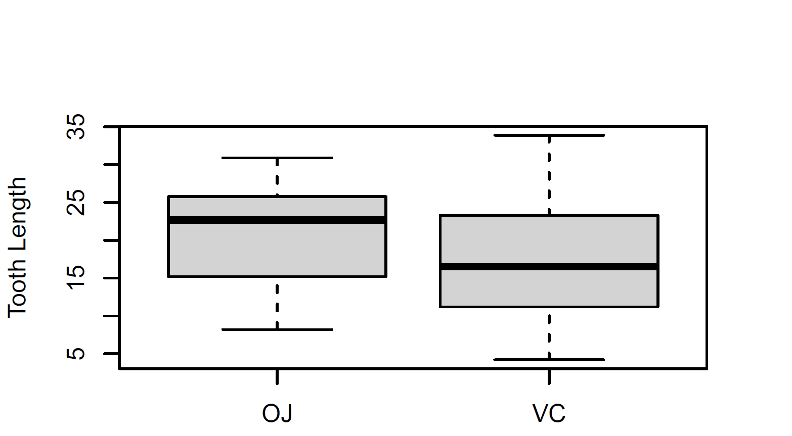
_{b}
n.s.
_{a}

Slide 27


